Slide 1
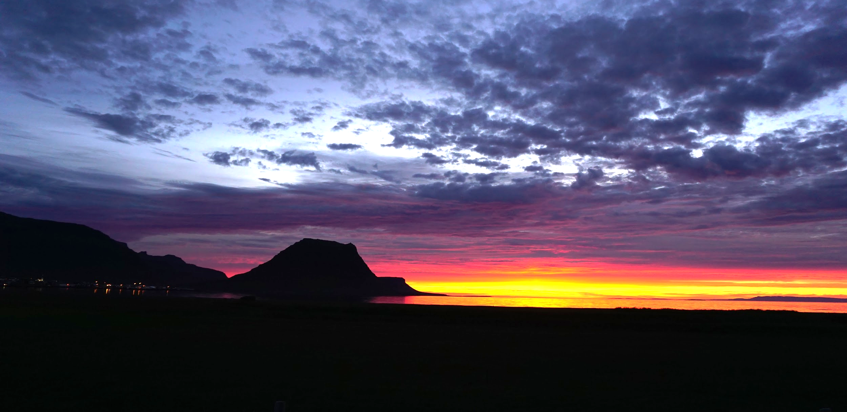


Slide 2

HELLO!
HI, I’M KAT
I love travel, photography and video games.
UI/UX Designer
Future Code Ninja

Slide 3
PROJECT BACKGROUND
Something you can use to plan, book and share a trip so that others can 'follow' you along your journey or be inspired to take a journey themselves.

Slide 4
$129B
$21B
Activities is the third largest segment of travel at $129B
Online tours and attraction bookings will more than double from $9 billion in 2015 to $21 billion in 2020.
https://www.trekksoft.com/en/blog/65-travel-tourism-statistics-trends-for-2018

Slide 5
We are in an "experience" economy, where people are preferring to spend their money on experiences rather than material things.
https://www.trekksoft.com/en/blog/65-travel-tourism-statistics-trends-for-2018

Slide 6



TRAVEL DIGITAL LANDSCAPE
routeperfect
ONLINE & MOBILE GROUP TRAVEL PLANNING + DOCUMENT STORAGE
AUTOMATED TRAVEL PLANNING - ACTIVITIES PICKED BY AI
AUTOMATED TRAVEL PLANNING WITH BETTER FILTERS - ACTIVITIES PICKED BY AI
What makes these sites work well?
Each offers a unique way to plan and book travel
Travefy is the only one to offer document storage and more of a customized way to build your trip
What opportunities do we have to redefine the way people plan travel?
All three lack user generated content
All three look more like partnerships with various travel activity sites

Slide 7
USER RESEARCH
1

Slide 8
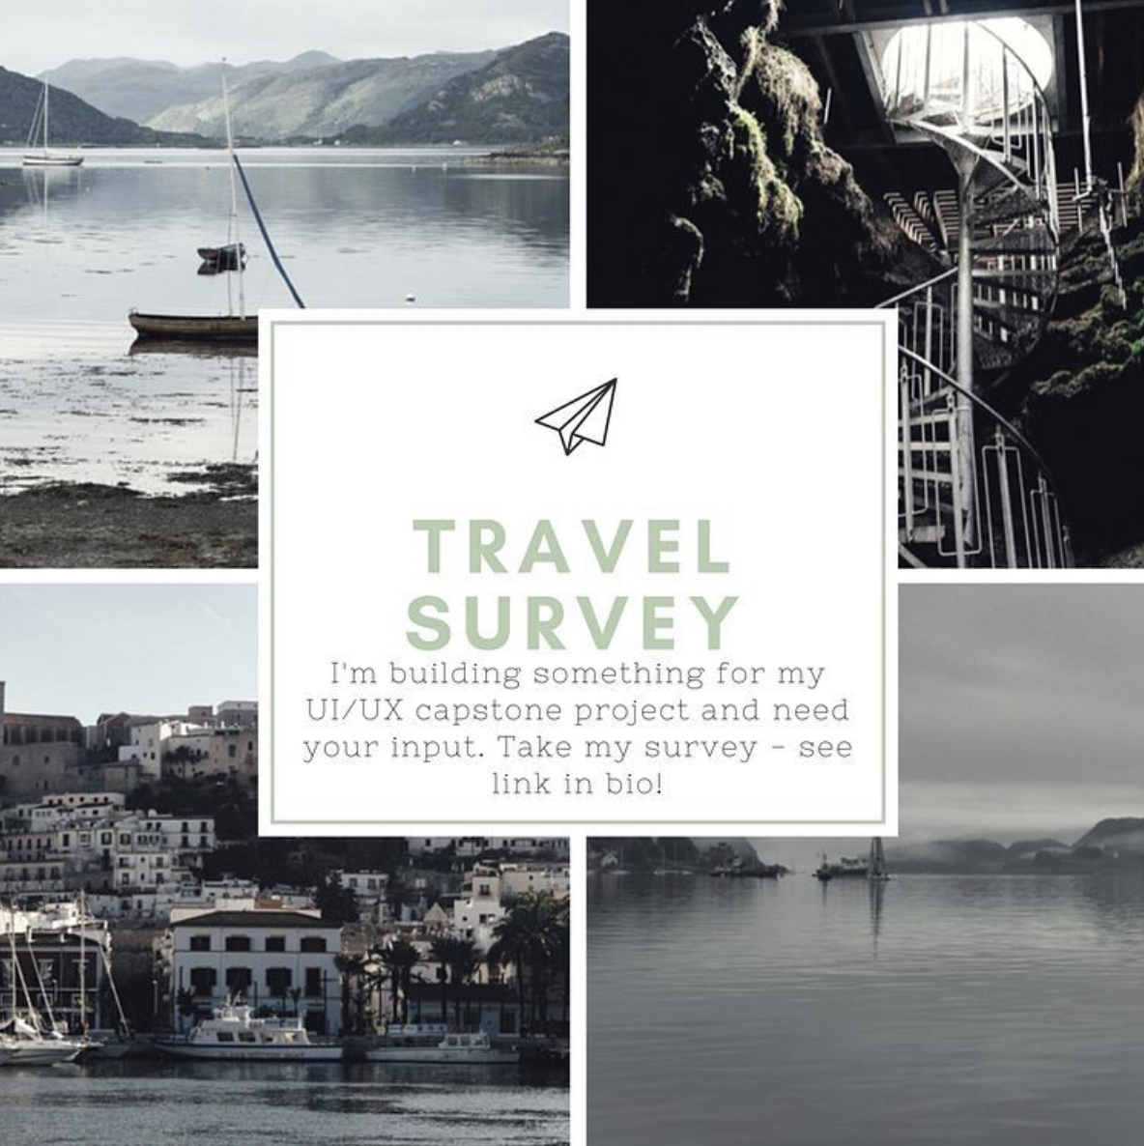
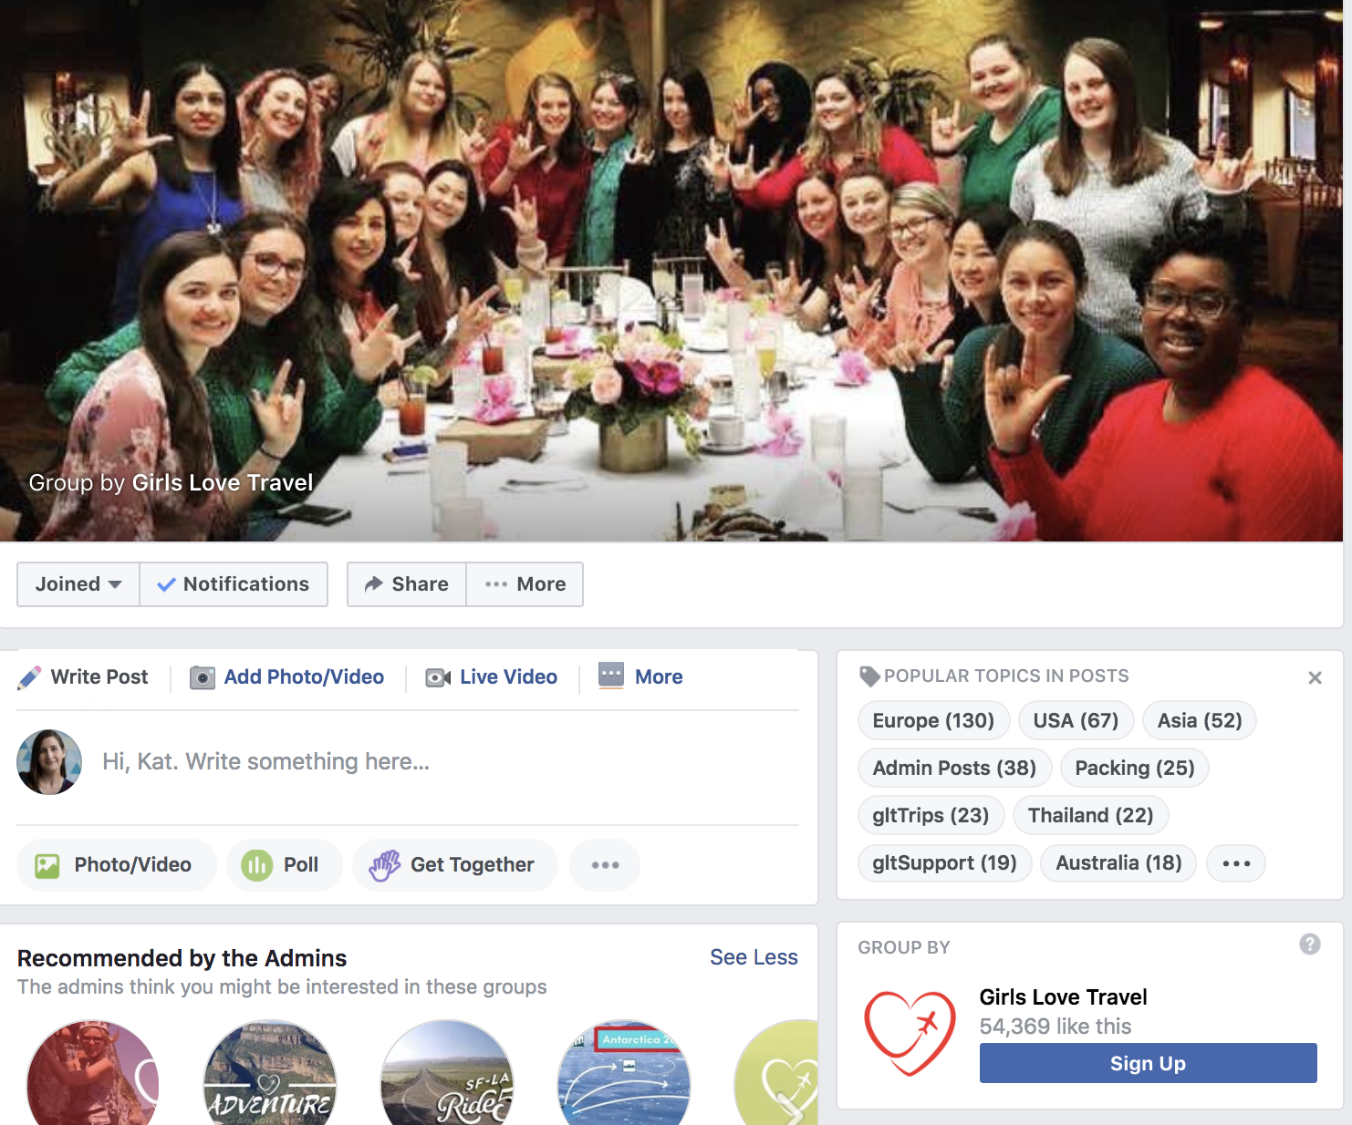
USERS TO TARGET FOR RESEARCH
GIRLS LOVE TRAVEL: FACEBOOK GROUP

Slide 9
USER SURVEY: 70 RESPONDENTS
QUANTITATIVE RESULTS
53% Travel 1-2 Times Per Year
46% Travel 3+
Times Per Year
50% Use a Travel website
23% Ask Others for Referrals
FREQUENCY
73% Pre-Plan Their Travel Arrangements
DISCOVERY
PLANNING

Slide 10
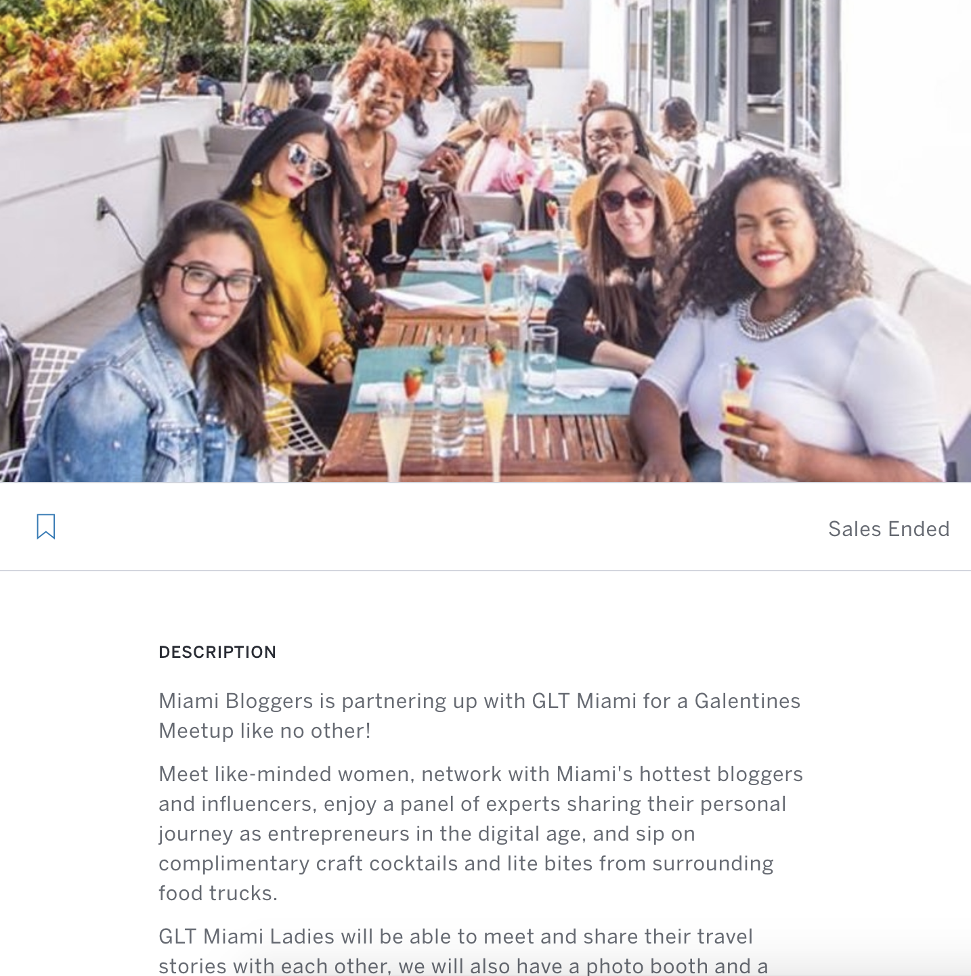
USER INTERVIEWS: 5 PARTICIPANTS
“Rick Steves is like the Bob Ross of Travel. I love his travel videos!”
“Travel website recommendations don’t feel authentic - I ask for recommendations on Facebook”
GLT Miami Galentines Meetup + Blogger Happy Hour
“I’m pretty good on organizing my trip documents. I don’t need anything beyond Google Drive.”
“Travel websites are just a minefield of popups and new tabs opened without your permission”

Slide 11
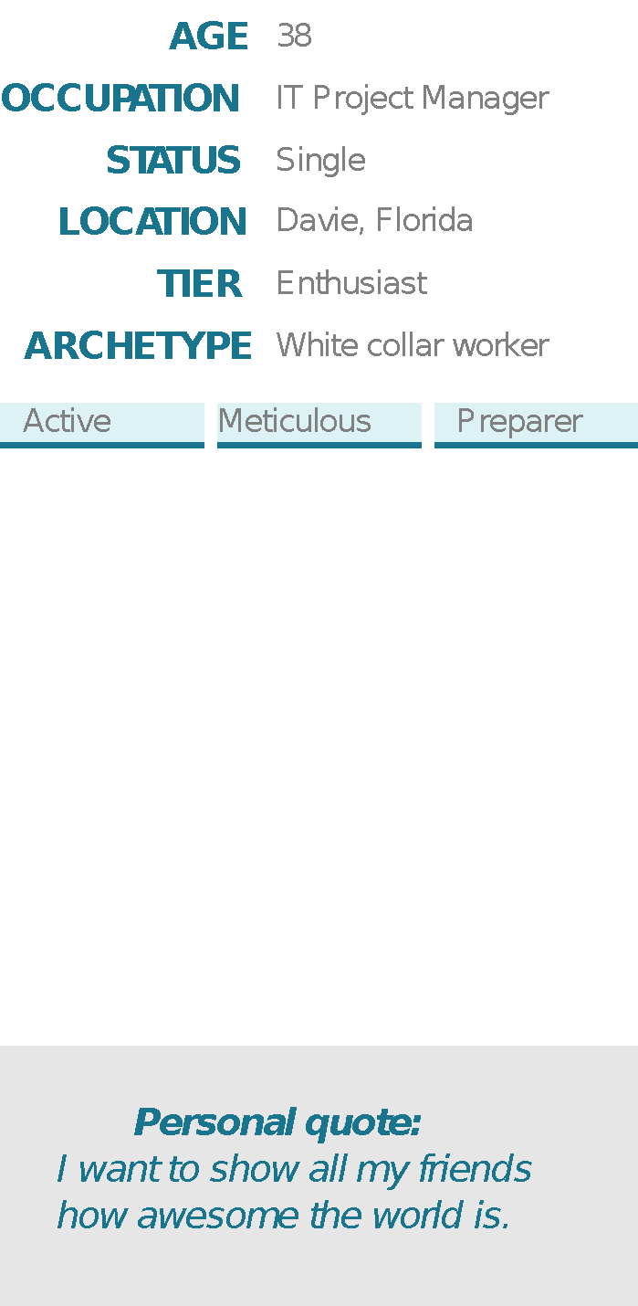
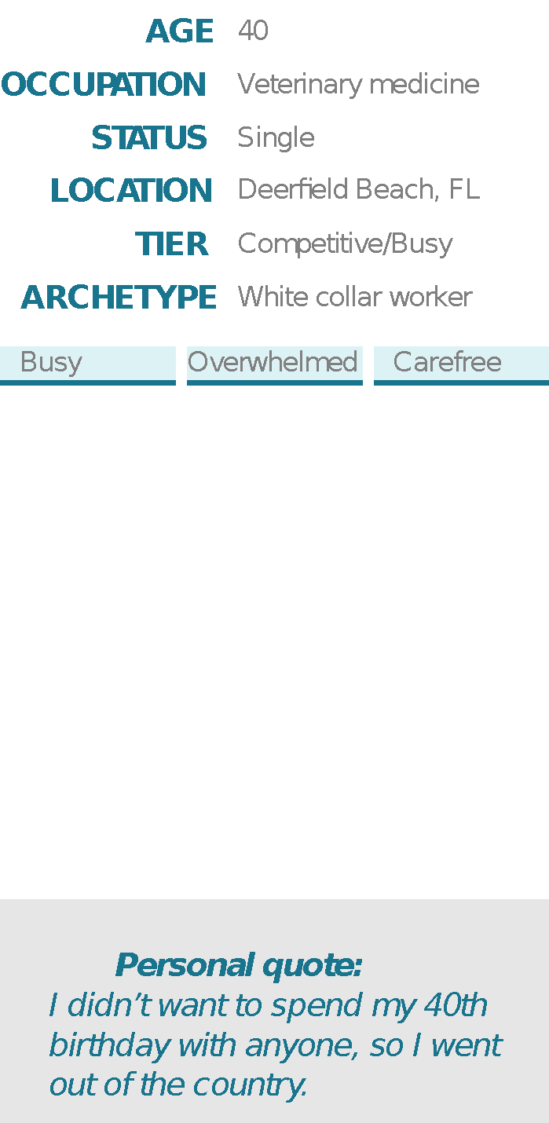
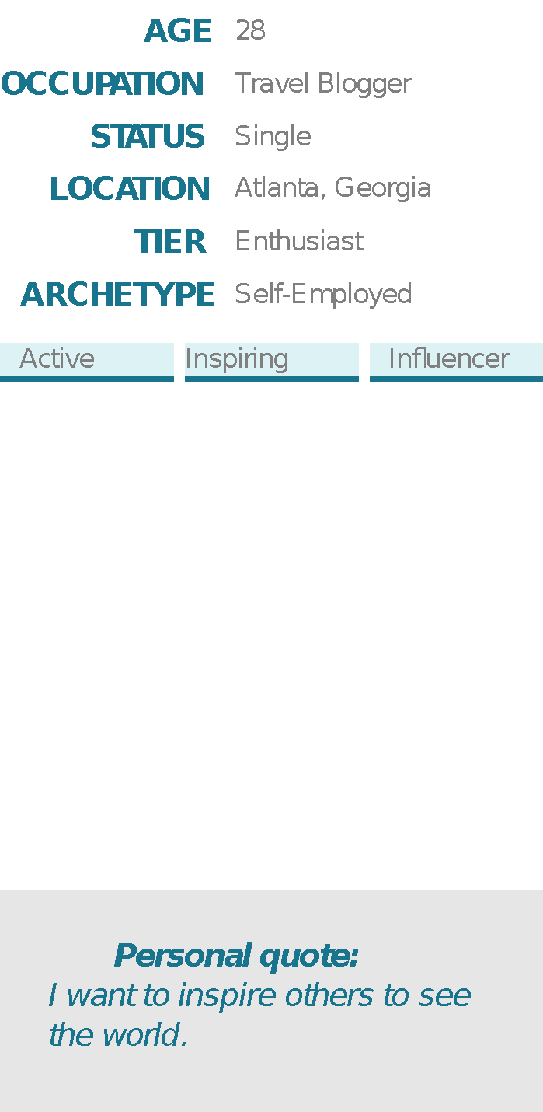



USER PERSONAS
FREQUENT FIONA
CURIOUS CYNTHIA
TRAVELISTA TERRI

Slide 12
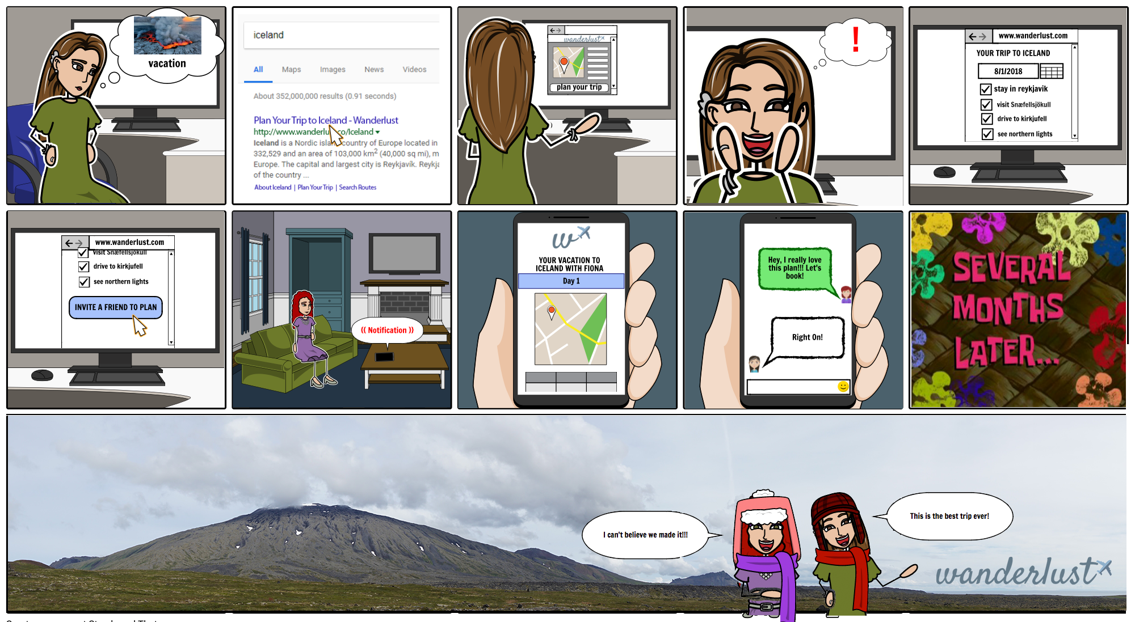
STORYBOARD

Slide 13
PROBLEM STATEMENT
A DEEPER CONNECTION
Travelers need a way to discover authentic and unique experiences in new destinations because it will enable them to make a deeper connection with the location they are exploring.

Slide 14
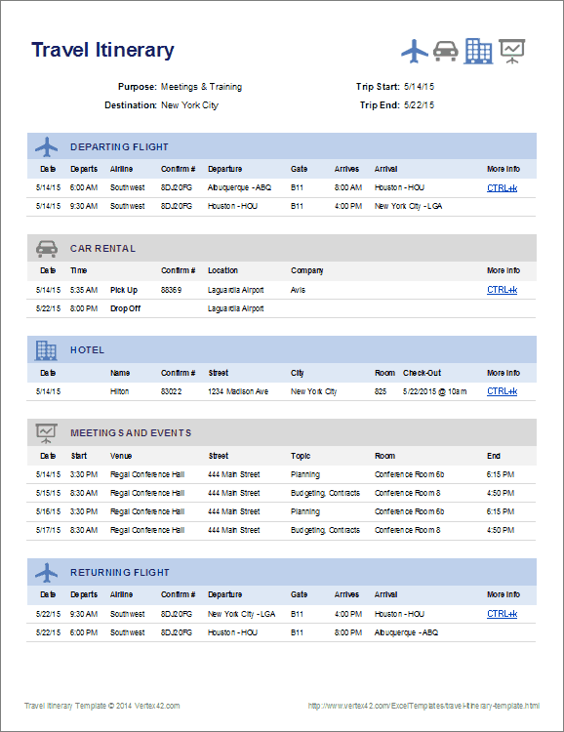
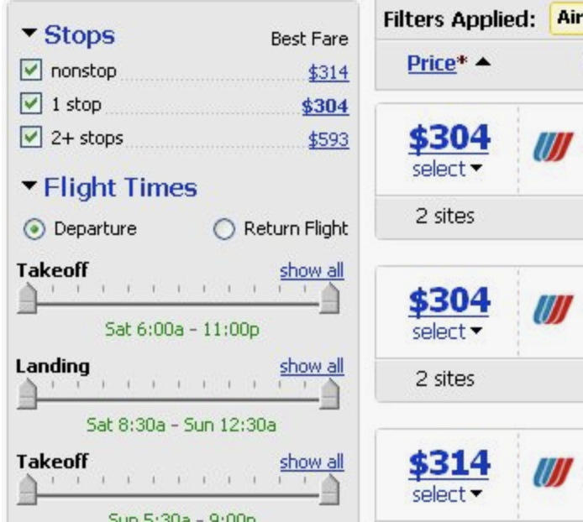


WANDERLUST FEATURES
CURATED ITINERARIES
ENHANCED
FILTERING
SOCIAL
PLANNING
SHARING
OPTIONS

Slide 15
INFORMATION ARCHITECTURE
2

Slide 16
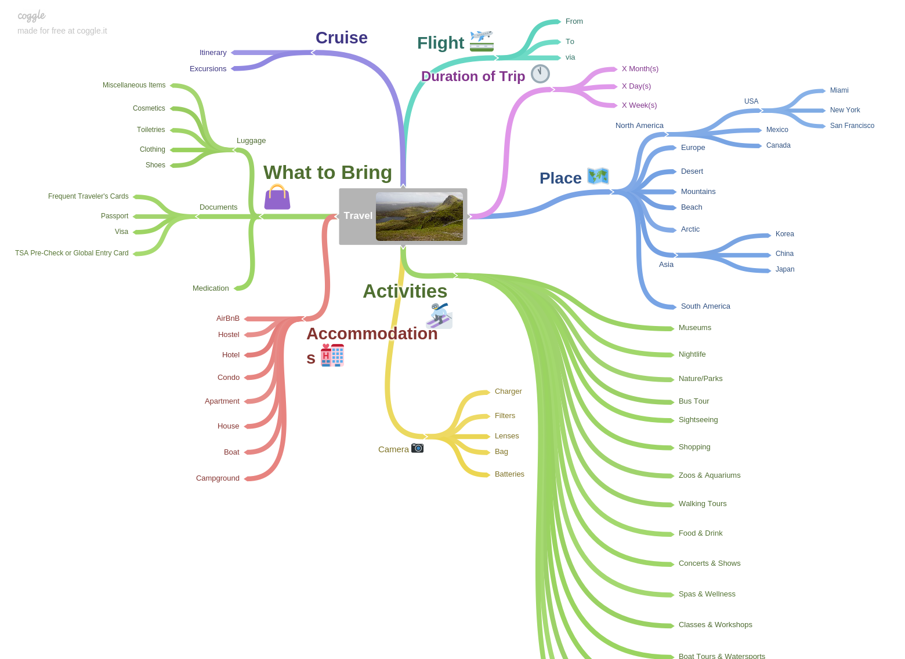
MIND MAP
s

Slide 17
SITEMAP
Navigation
- Explore
Search
View Trips
Login/Signup
Flag/Currency
Homepage
- Search for destination
- Browse Itineraries
- Browse Content
Destination
- Attractions
Events
Outdoor Activities
Food and Drink
Shopping
Itineraries
Tours
Wildlife
Landscapes
Did you know / tips
My Trips
- Create New Trip
Continue Planning
View Trip
Cancel (Delete) Trip
See Cancelled Trips

Slide 18
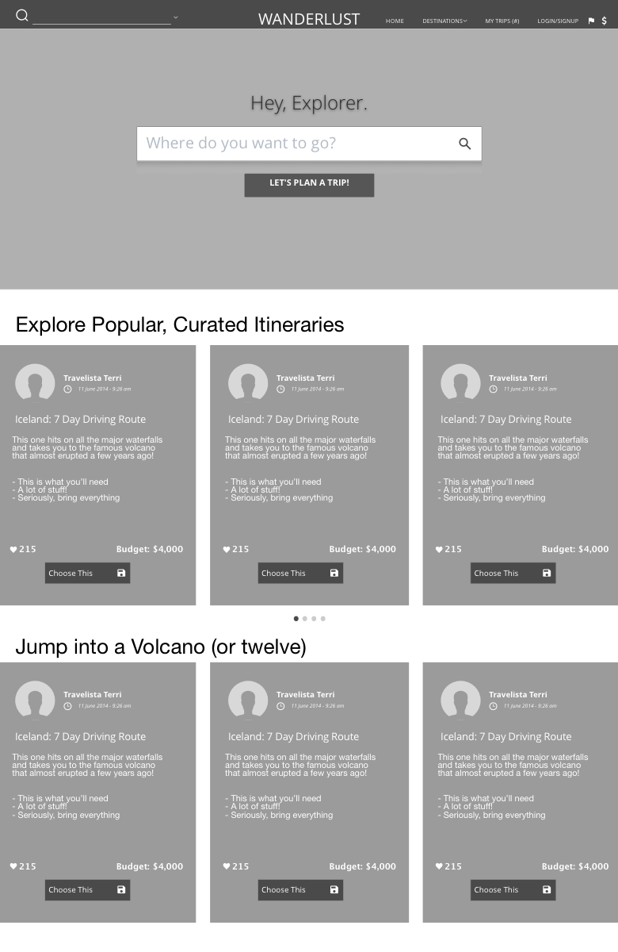
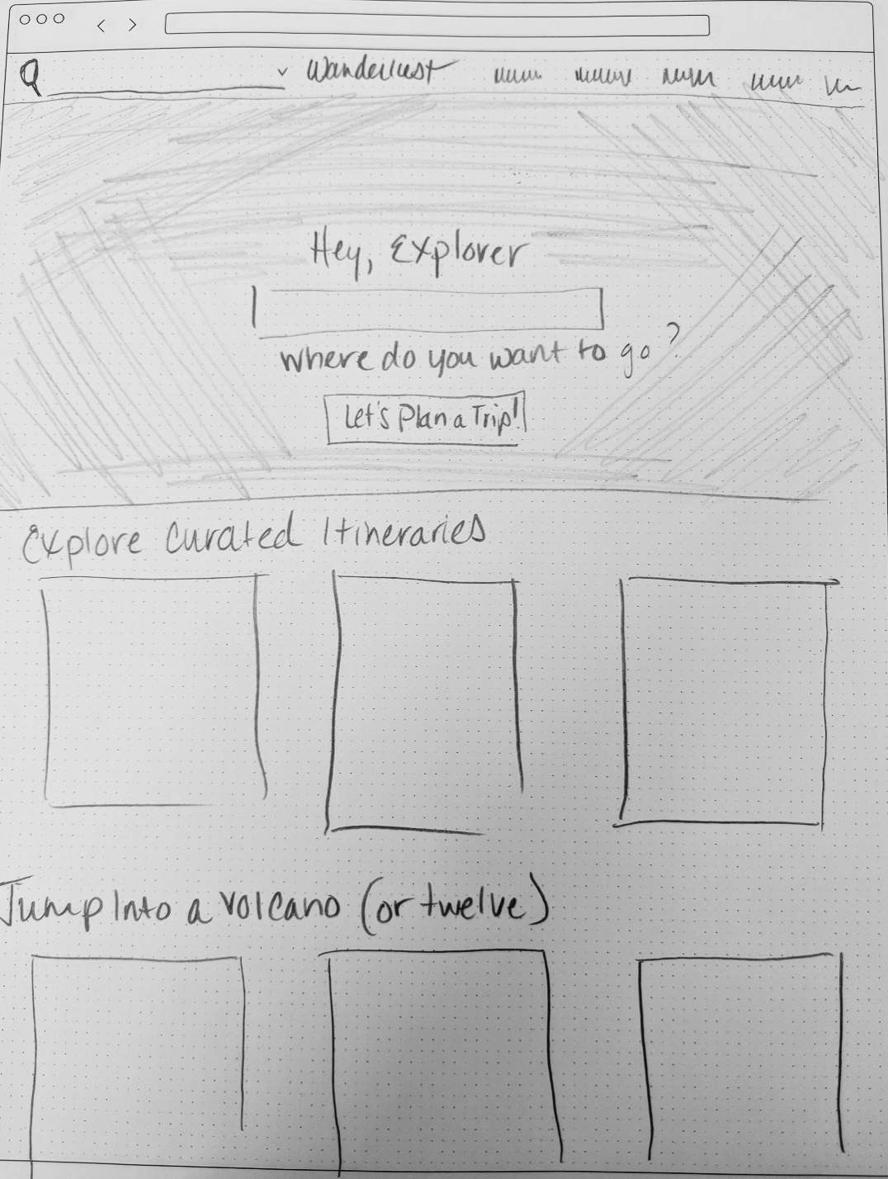
LOW & MID FIDELITY WIREFRAMES
HOMEPAGE
Problem Point:
Users thought the page was boring.

Slide 19
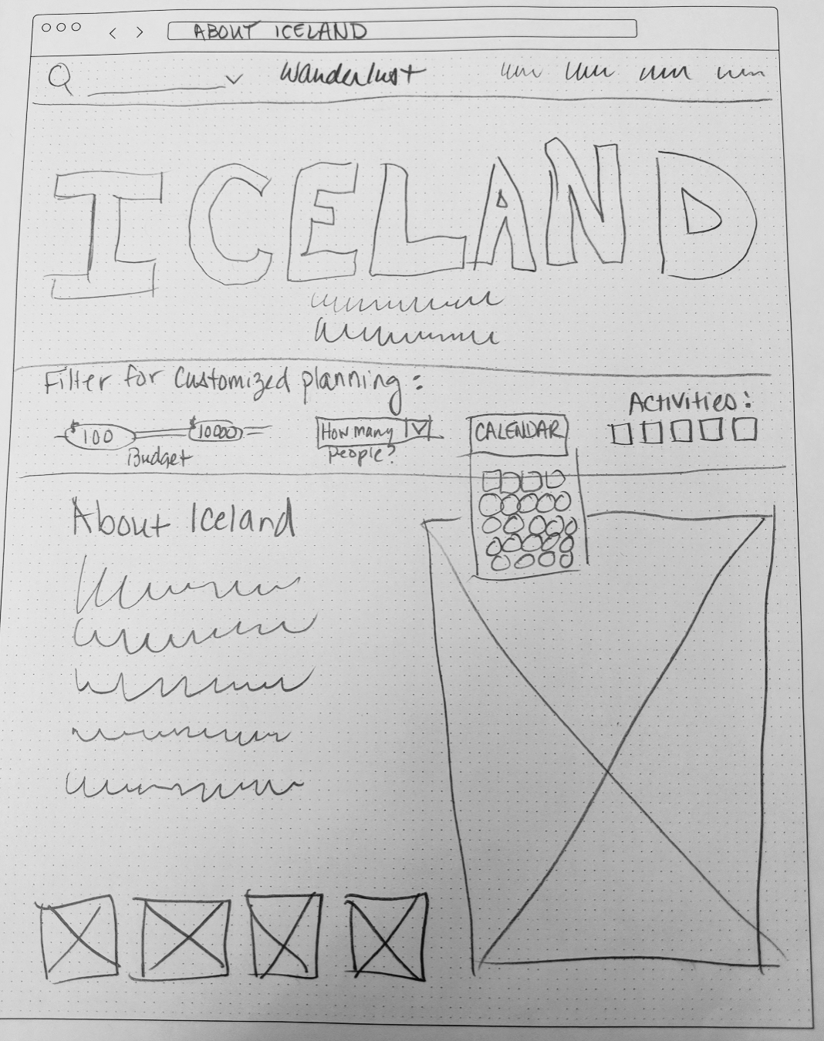
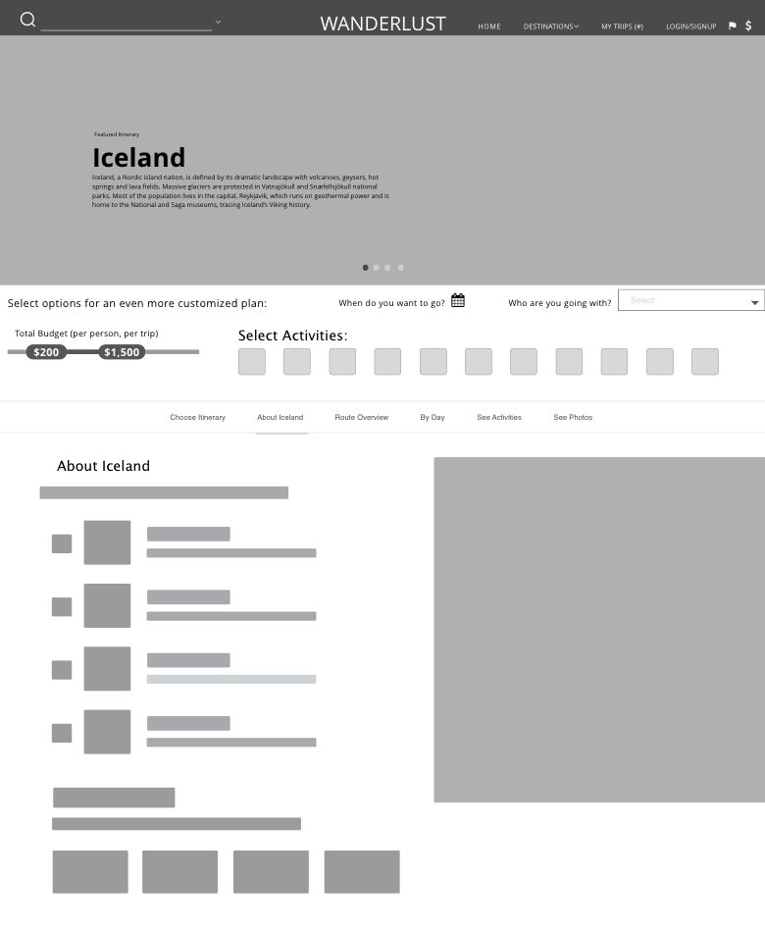
LOW & MID FIDELITY WIREFRAMES
ABOUT
DESTINATION
Problem Point:
Users had trouble with the filters

Slide 20
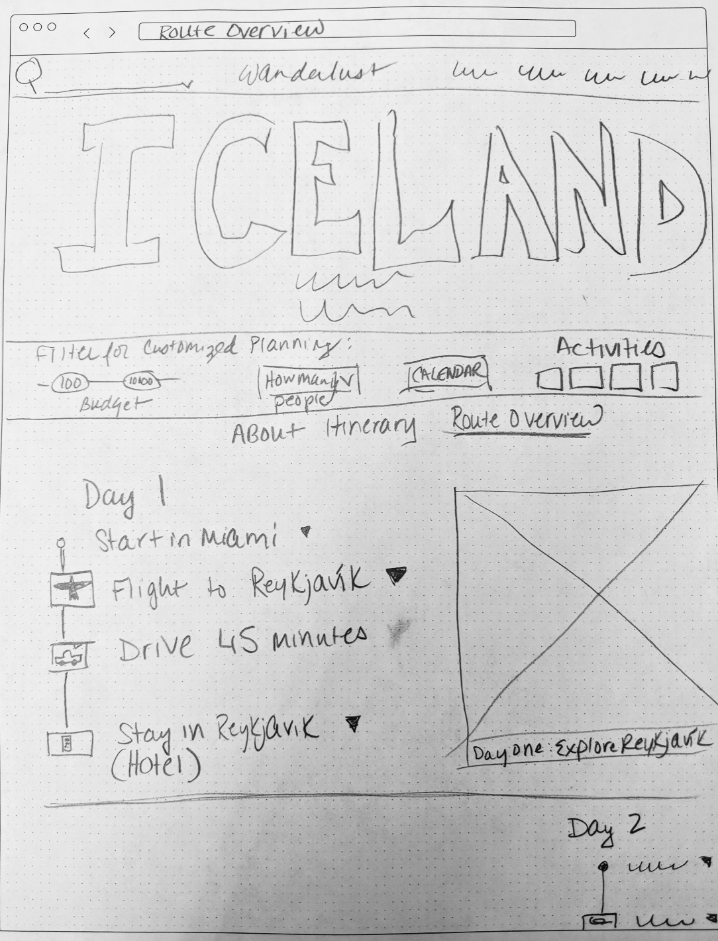
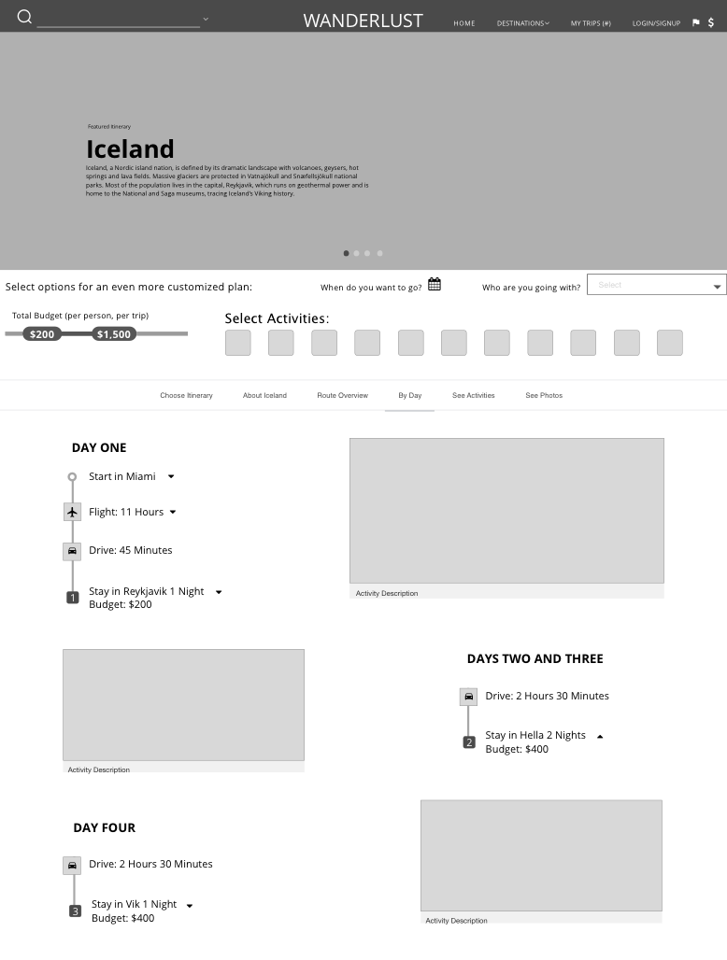
LOW & MID FIDELITY WIREFRAMES
ROUTE OVERVIEW
Problem Point:
Users didn’t understand how to change activities.
It was hard for them to understand what these pages were even about.

Slide 21
VISUAL DESIGN
3

Slide 22

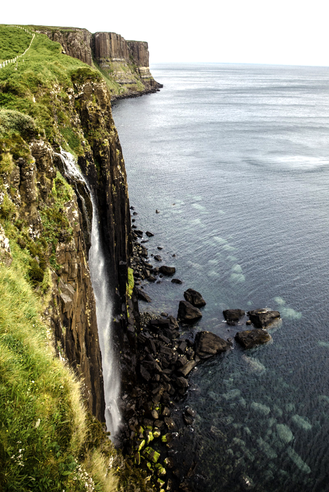
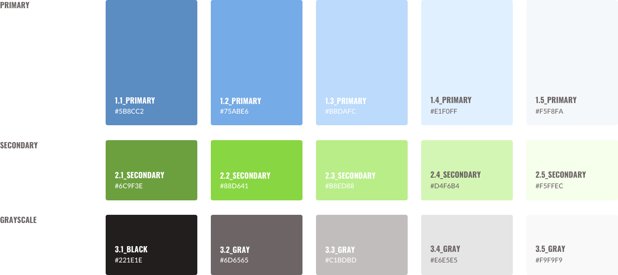
COLOR PALETTE

Slide 23
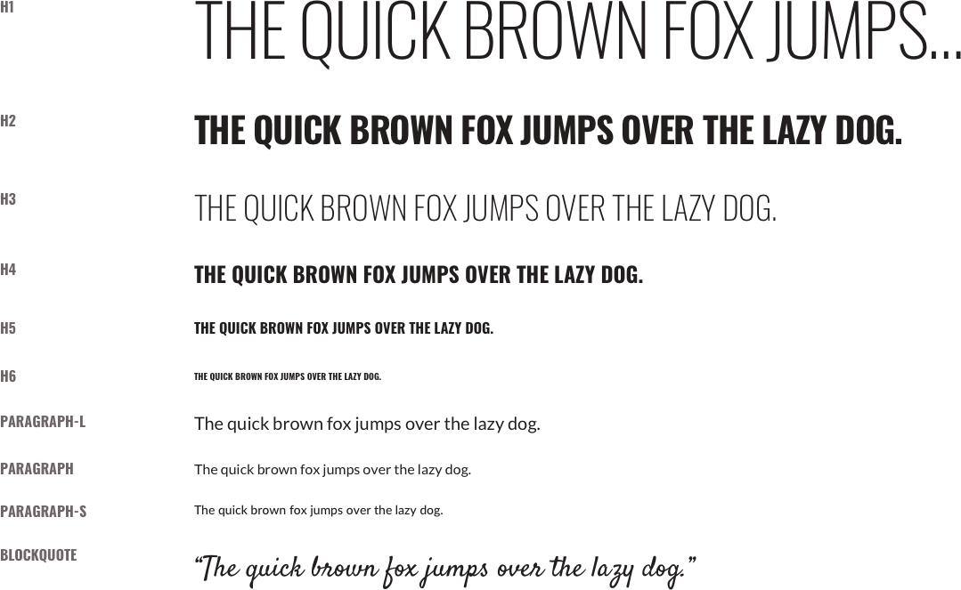
TYPOGRAPHY: OSWALD & LATO

Slide 24
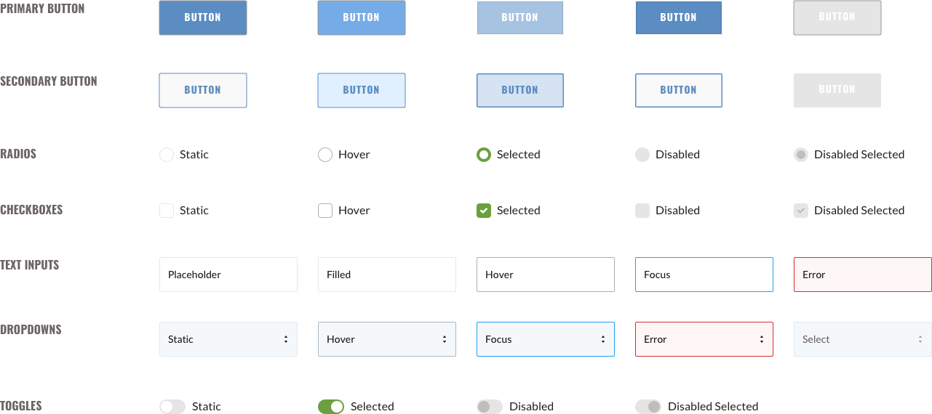
INPUTS & BUTTONS

Slide 25
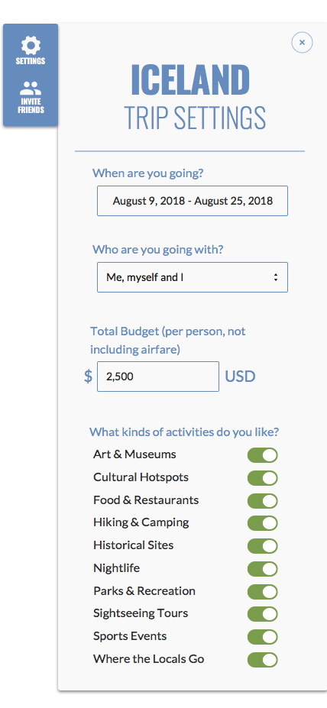
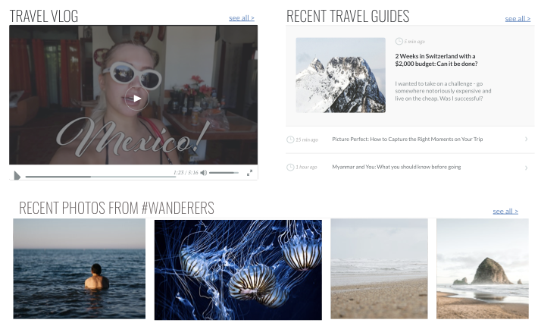
REVISIONS
RETHOUGHT FILTERS
HOMEPAGE - ADDED CONTENT

Slide 26
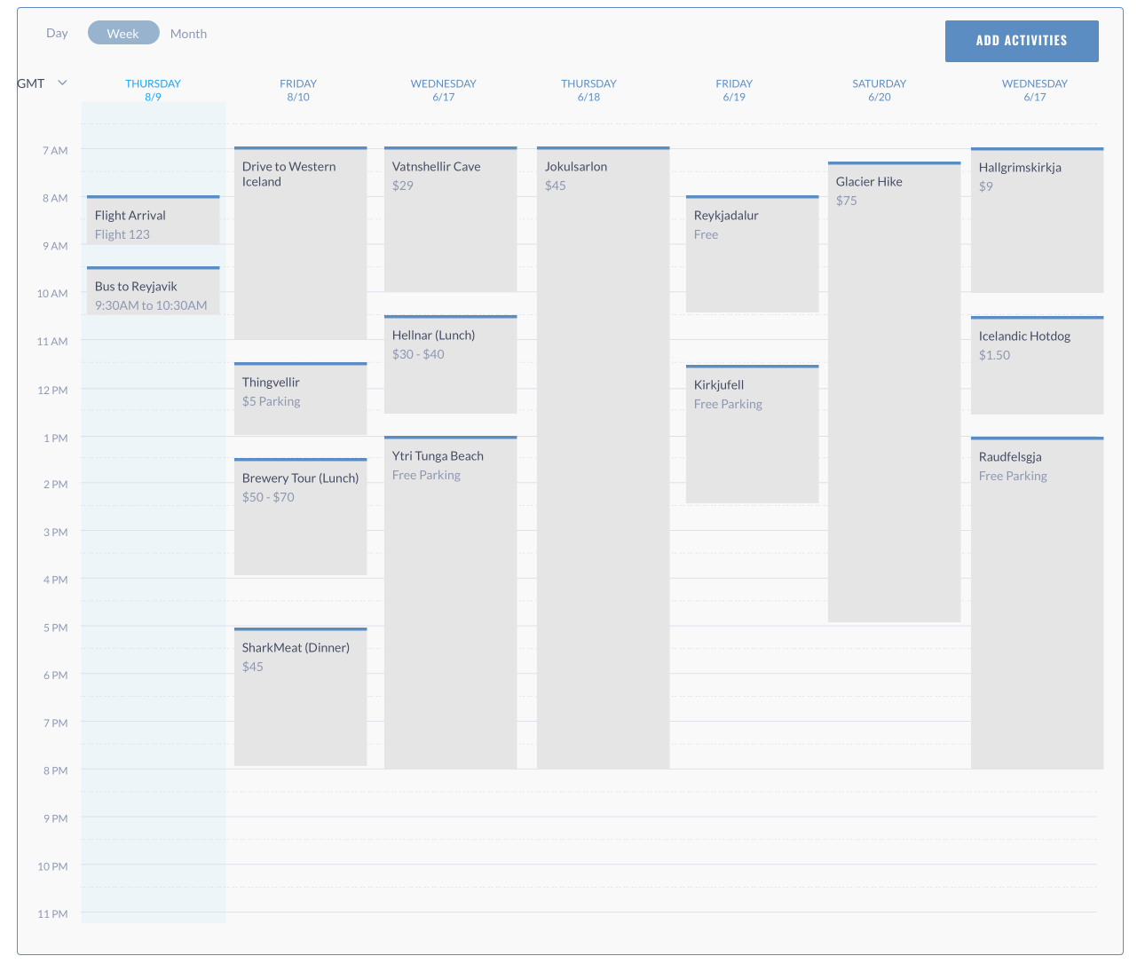
REVISIONS
OVERHAUL OF CALENDAR

Slide 27
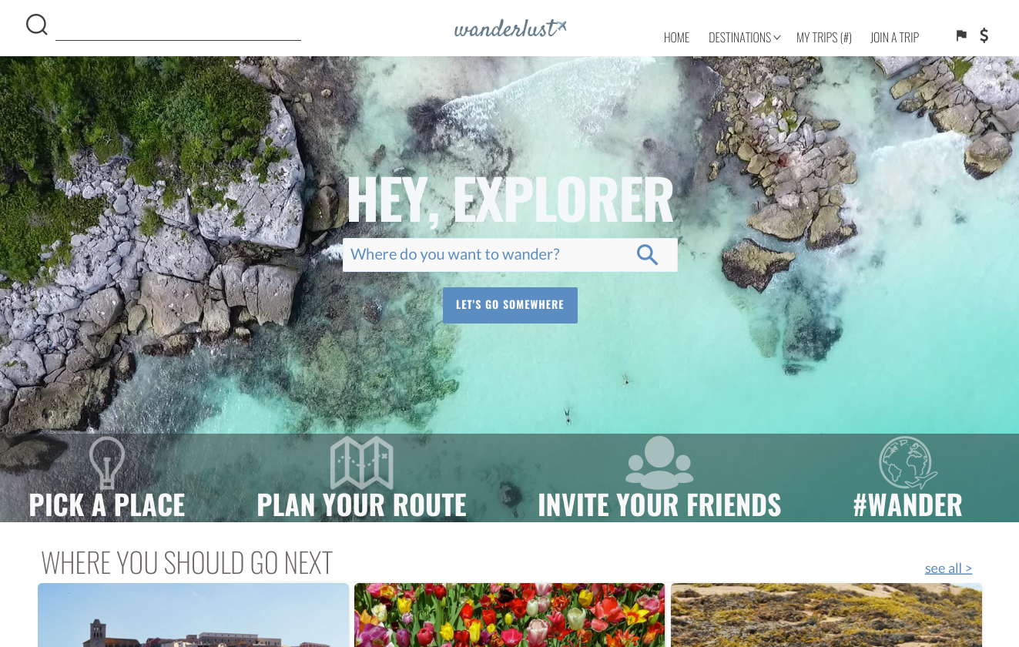
FINAL MOCKUP: HIGH FIDELITY

Slide 28
PROTOTYPE
4
Invision Link:
https://invis.io/SWG64NSAZ2B#/283034758_Homepage

Slide 29
THANKS!
Any questions?
You can find me at
www.uxkat.co
email: kat@uxkat.co

